Slide 1
Deploying EDA Workloads On Public Cloud
Melvin Cardozo

Slide 2
Topics
Cloud Motivations
EDA compute workloads on Traditional, Cloud-First, Hybrid infrastructure
Cloud Native Infrastructure and Terminology
Customer Cloud Challenges
Current Cloud Status For Synopsys Tools
Case Study 1 - VCS
Case Study 2 – PrimeTime, ICV2
Synopsys Confidential Information - Internal Use Only

Slide 3
Cloud Motivations
Synopsys Confidential Information - Internal Use Only

Slide 4
Cloud Participants in EDA
Motivation:
Best / fastest engines
Take advantage of h/w
Motivation:
Optimize the use of HW farm spend
Use the best tools, methodology
EDA Customer
EDA Vendor
New Motivation:
Use elastic & unlimited scale to improve product vs competition
Make money off software in this segment
Make money off special purpose hardware in this segment
New Motivation:
Short term project-specific needs
Improve TTR, QoR
Managed Services
New business (ARM, AMD, nvda, xlnx)
Cloud Vendor
New Motivation:
Make money from HW & managed services
EDA compute is a big target (with specific infra requirements)
HW Vendor

Slide 5
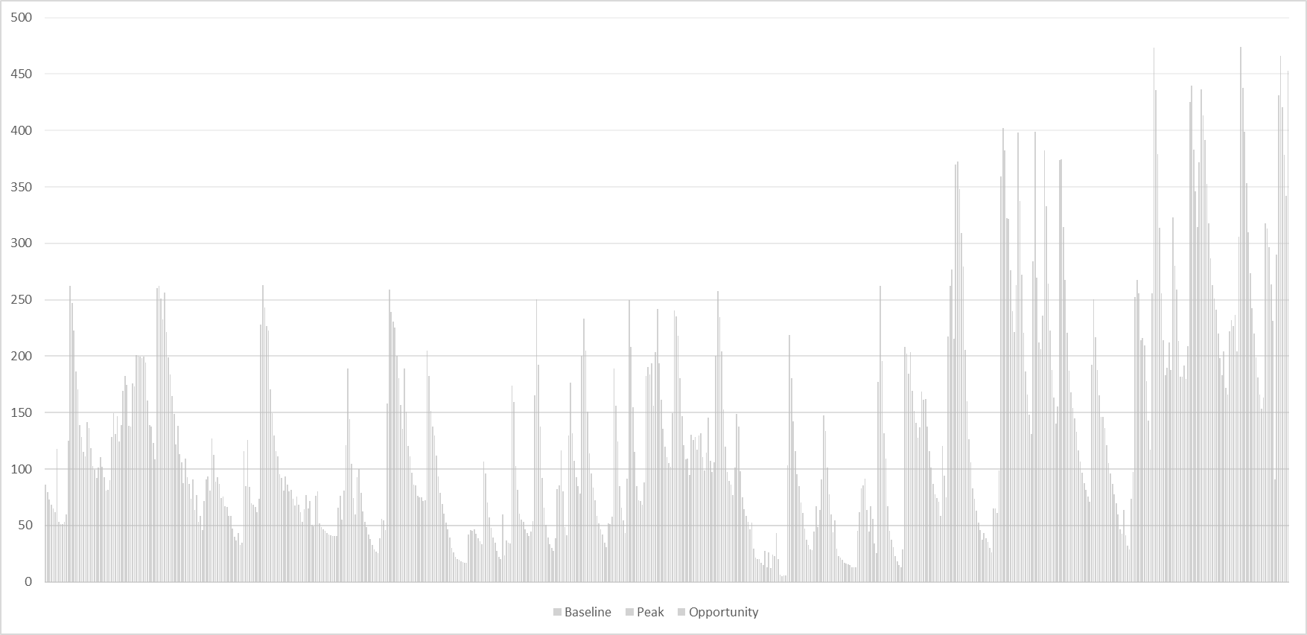

Astera Labs: VCS on Amazon Cloud
Actual Usage with Hourly License Model
87,078 License-hours over 28 days
Equivalent Usage with TSL Model
87,078 License-hours over 227 days
Simulation License-Hours
Simulation License-Hours
16
28 days with unlimited VCS licenses
227 days with 16 VCS licenses
Cloud can enable huge shift-left!
Customer had only 16 VCS licenses available under TSL model
Monitored real project use with “unlimited” cloud access to VCS – 87K license-hours used in 1 month
Cloud access effectively delivered 8x faster TAT and 6+ months shift-left

Slide 6
Traditional, Cloud-First & Hybrid Cloud
Synopsys Confidential Information - Internal Use Only

Slide 7
Verification on Cloud Segments
 | Large Semi | Mega Disruptors | Startup Semi
Description | Traditional chip design companies with on-premise resources for EDA workloads | Companies which provide web services, products, platforms & infrastructure; moving into value added chip designs | Small, new fabless semiconductor companies looking to bring initial products to market quickly
Large, existing IT team and compute infra | Yes | Yes | No
Large, legacy EDA infrastructure | Yes | No | No
Existing compute infra designed for cloud-native workloads | No | Yes | No
Require “burst” access for peak or project use | Yes | No | No
CAPEX-constrained | No | No | Yes
Target cloud usage model | Hybrid for peak | Private | Public
EDA & related IT infrastructure spend | $$$ | $$ | $
Examples | AMD, Intel, Nvidia, Qualcomm, Samsung, Broadcom, ARM, Xilinx | Google, Amazon, Microsoft, Facebook, Baidu, Alibaba | Astera Labs, Groc, Cerebras, Esperanto, Sambanova, Graphcore
90+%
Utilization

Slide 8
EDA workloads: Traditional Architecture
On Prem
Licenses
Users Access
VMs, Desktops, NFS
Tools and Workflows
NFS, multiple versions pre-installed
% setcluster local
% bsub -n 20 run.sh
On Prem
Compute
Grid software
Launch on pre-specified queues
Grid manager, queue
LSF / UGE / etc
Compute Layer
Bare Metal, Validated OS
Data and Storage Layer
NFS
On Prem NFS Storage
Synopsys Confidential Information - Internal Use Only

Slide 9
EDA workloads: Cloud First Architecture
One of several options, not including security, authentication, authorization
On Prem
Licenses
Users Access
VMs, Desktops, Distributed FS
Tools and Workflows
Local disk, Distributed FS, EDA Tools on read-only FS, containerization
Job Definition
Container
Cloud Orchestration
K8s, Borg, AWS Batch, Azure Batch
AWS Batch, K8s, Borg etc.,
Compute Layer
Containers, Contrainer registry, Orchestration
Obj Store
Posix Fuse
interface
Data and Storage Layer
Distributed FS, Persistent Disk, Tools on Read-only FS, Obj Store
Distributed FS, Persistent Disk Mount
Container
Registry
*: Discussions with AMZN, Google, MSFT
Synopsys Confidential Information - Internal Use Only

Slide 10
Hybrid cloud for traditional EDA users
On Prem
Licenses
Users Access
VMs, Desktops, NFS
Tools and Workflows
NFS, Data sync with cloud, tools installed on cloud
% setcluster [local, cloud]
% bsub -n 20 run.sh
On Prem
Compute
Cloud
Compute
Grid software
Launch on pre-specified queues
VPC
Network
Grid manager, queue
LSF / UGE / etc
Compute Layer
Bare Metal, Validated OS
Data Sync
Data and Storage Layer
NFS
Synopsys Confidential Information - Internal Use Only

Slide 11
Cloud Native Infrastructure And Terminology
Synopsys Confidential Information - Internal Use Only

Slide 12

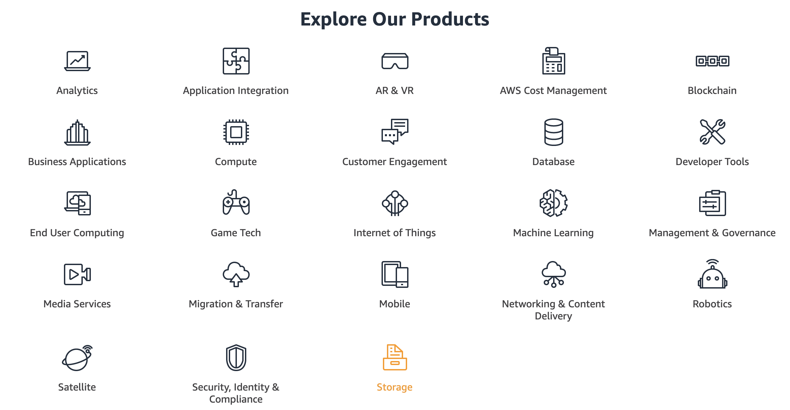
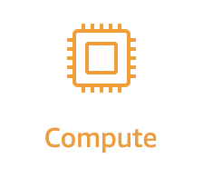
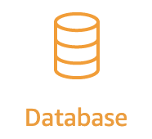

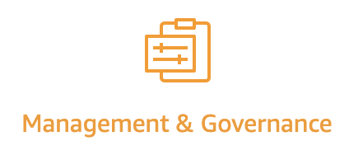

Amazon Cloud Offerings

Slide 13
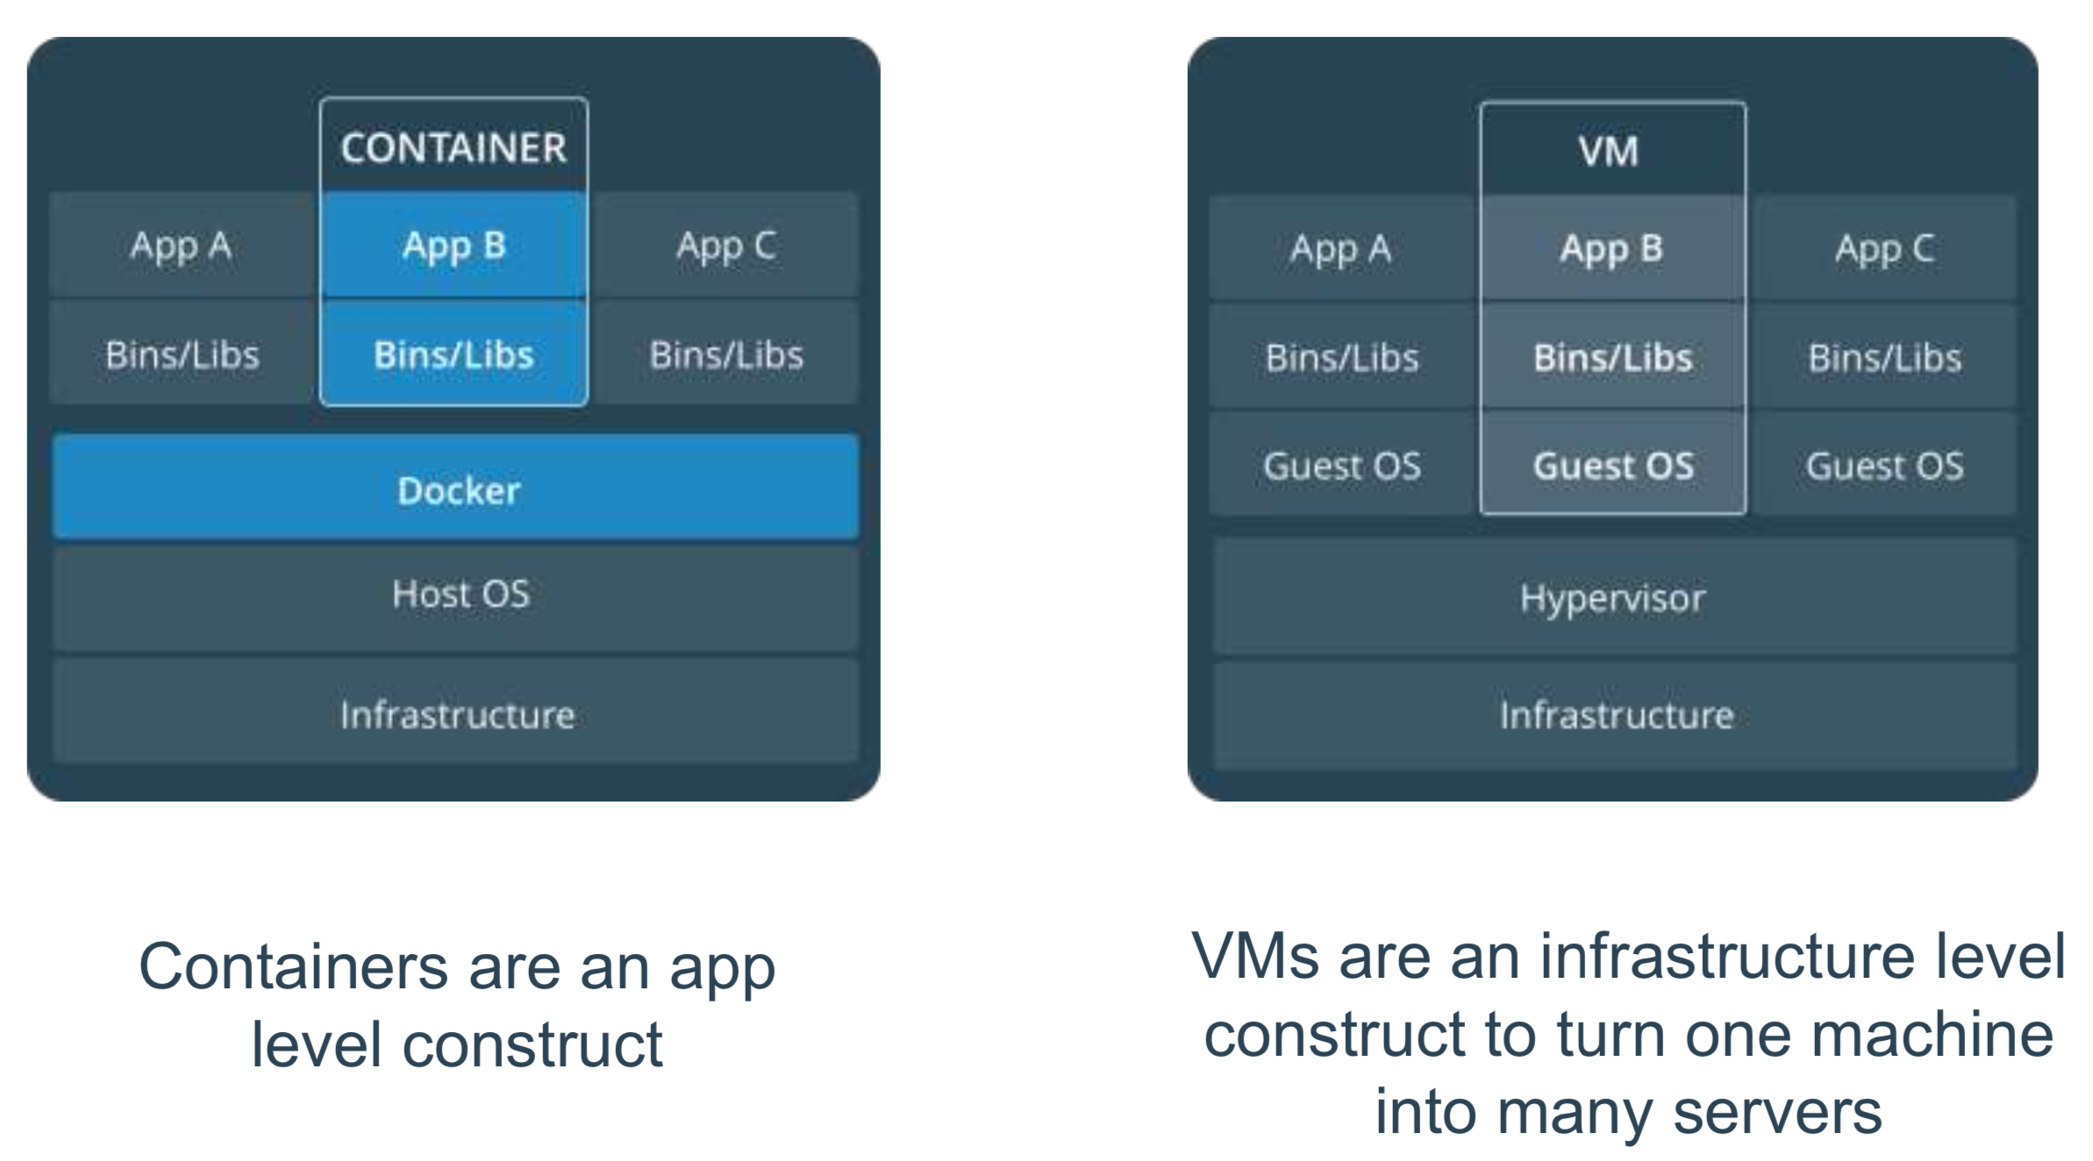
Containers v/s VMs

Slide 14
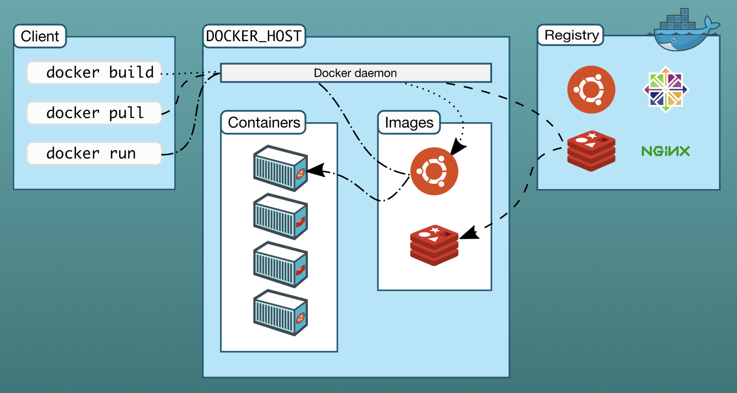
Docker Architecture

Slide 15
Docker Image v/s Container
Docker Image
Docker images are read-only templates from which Docker containers are launched.
Each image consists of a series of layers.
Docker makes use of Union file systems to combine these layers into a single image.
Docker Container
Container is built from an image.
A container consists of an operating system, user-added files, and meta-data.
That image tells Docker what the container holds, what process to run when the container is launched, and a variety of other configuration data.
The Docker image is read-only.
When Docker runs a container from an image, it adds a read-write layer on top of the image (using a union file system as we saw earlier) in which your application can then run.

Slide 16
Docker Image Registry
Images are stored locally, but can be pulled from an Image registry
The Registry is a server that stores and lets you distribute Docker images.

Slide 17
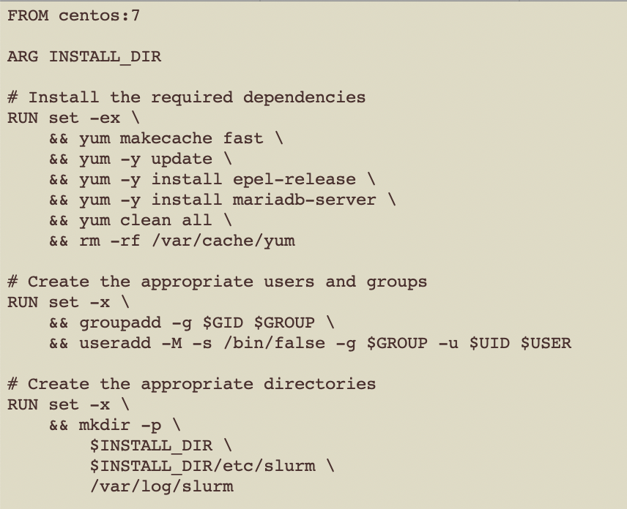
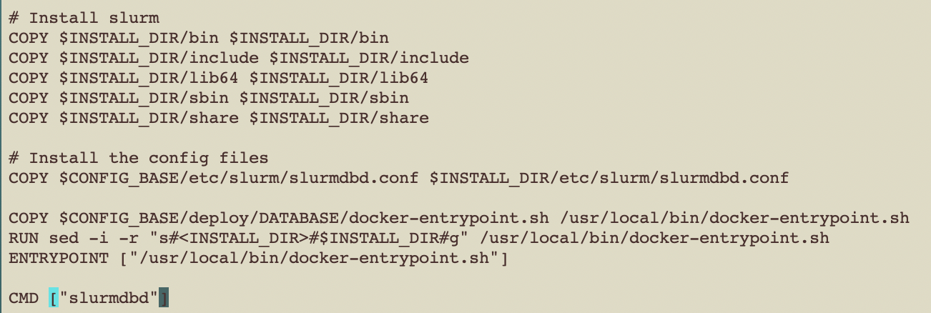
Dockerfile

Slide 18
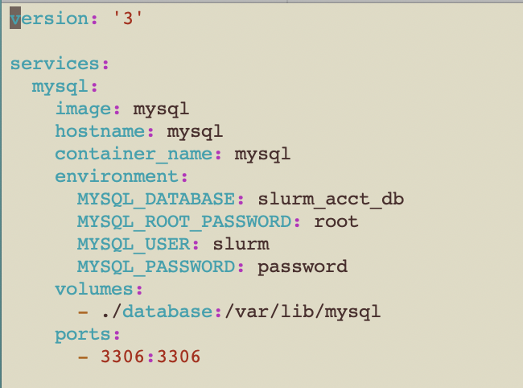
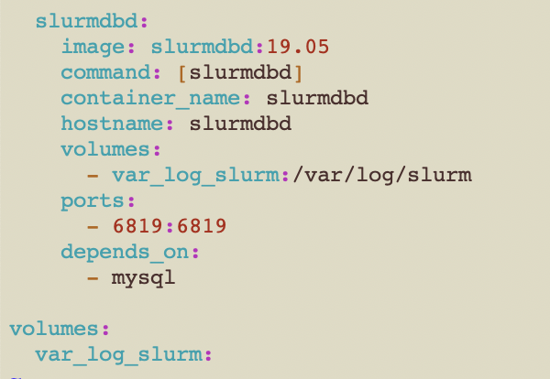
Docker Compose

Slide 19
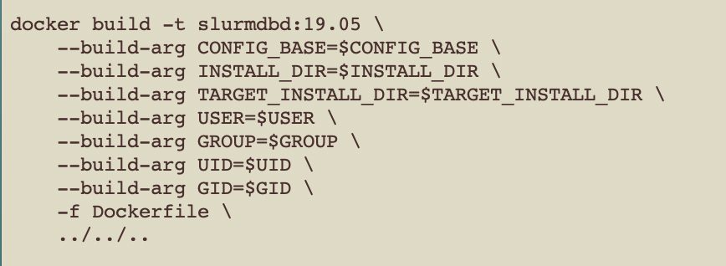
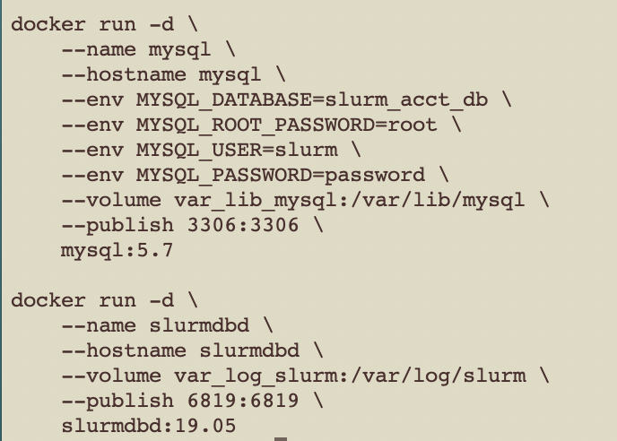

Docker Build & Run

Slide 20
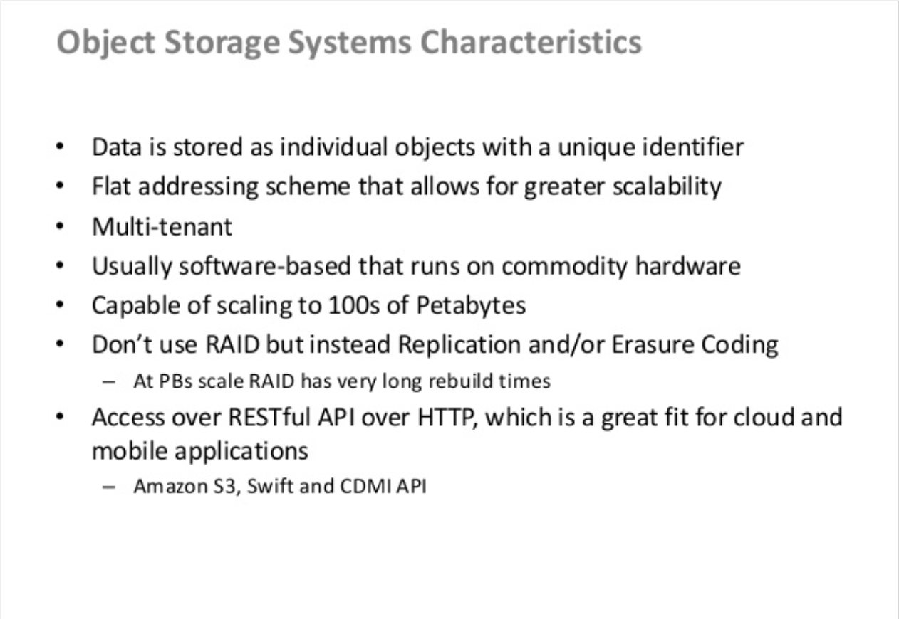
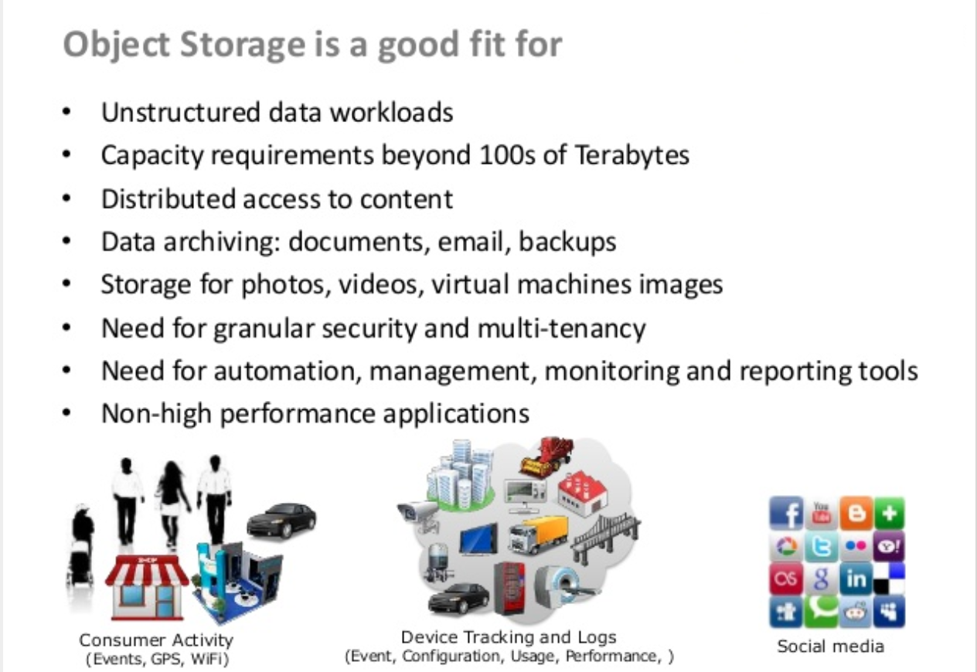
Object Store

Slide 21
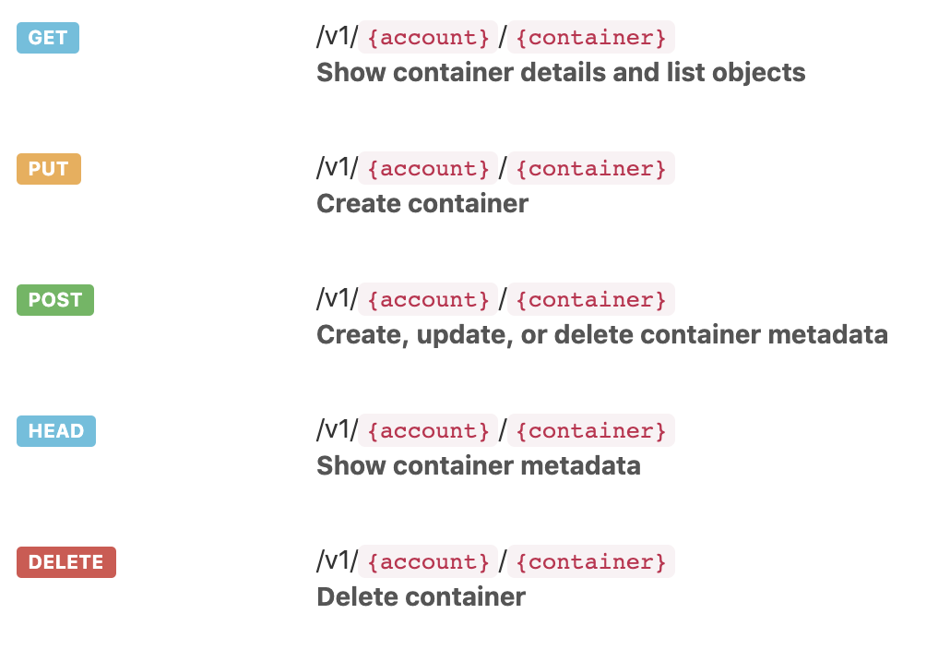
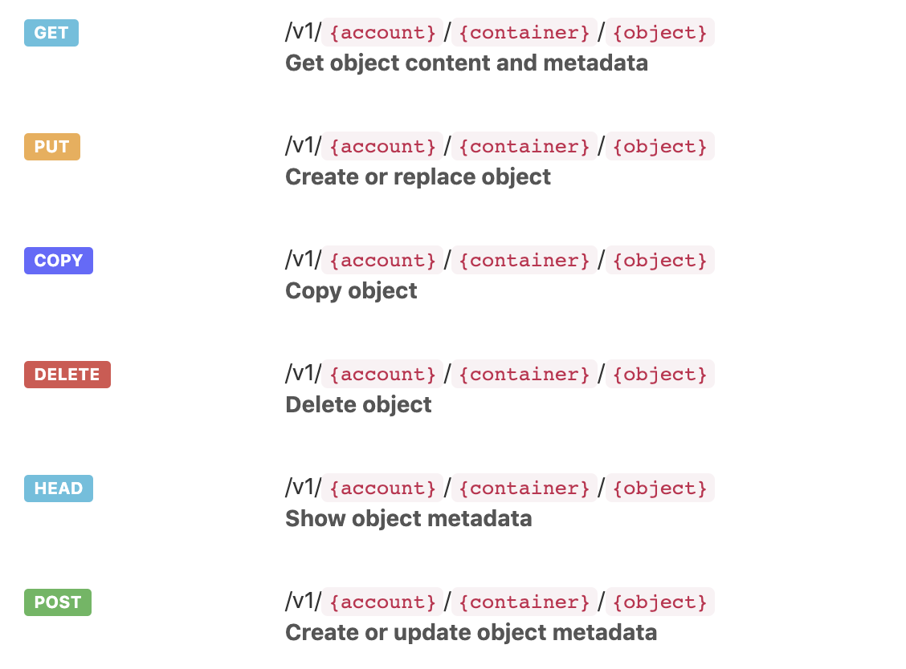
Object Store APIs
Container/Bucket
Objects

Slide 22
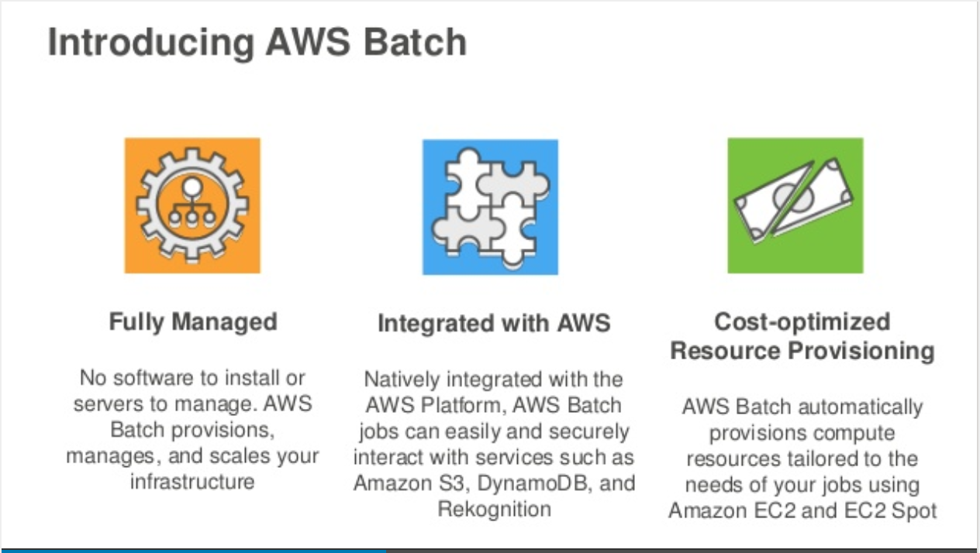
Batch Schedulers

Slide 23
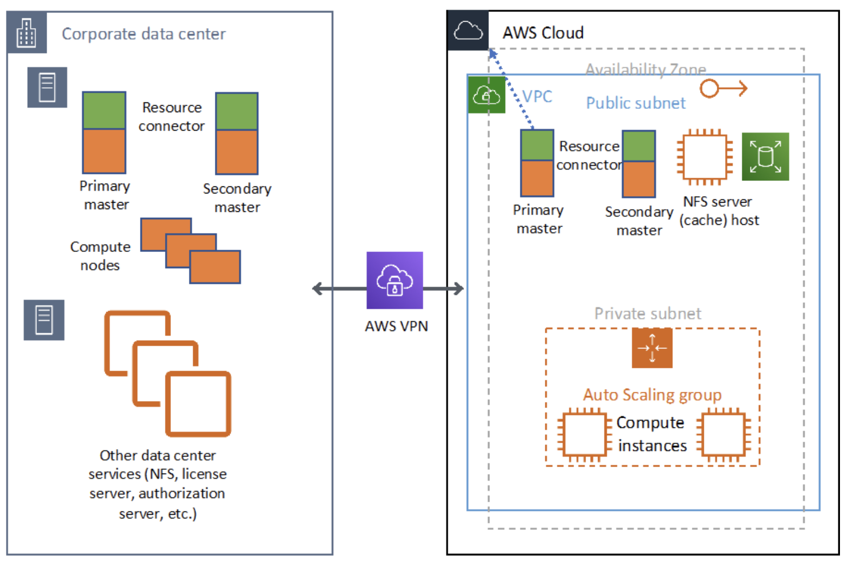
LSF Connect

Slide 24
Cloud Pricing - AWS
<50%
Utilization
Instance Types | Cores | Memory (MB) | Disk | Description | OnDemand Price | Spot Price
t3.nano – t3.2xlarge | 1 - 4 | 0.5 - 32 | EBS | 0.5GB/core | $0.005 - $0.332 | 32%
c5.large – cg.24xlarge | 1 - 48 | 4 - 92 | EBS | 4GB/core | $0.085 – $4.08 | 38%
c5d.large – c5d.18xlarge | 1 - 36 | 4 - 144 | 50G – 1.8T | 4GB/core, SSD | $0.096 - $3.456 | 33%
m5.large – m5.24xlarge | 1 - 48 | 8 - 345 | EBS | 8GB/core | $0.096 - $4.608 | 35%
m5d.large – m5d.24xlarge | 1 - 48 | 8 - 345 | 75G – 3.6T | 8GB/core, SSD | $0.113 - $5.424 | 30%
r5.large – r5.24xlarge | 1 - 48 | 16 - 768 | EBS | 16GB/core | $0.126 - $6.048 | 28%
r5d.large – r5d.24xlarge | 1 - 48 | 16 - 768 | 75G – 3.6T | 16GB/core | $0.144 - $6.912 | 25%
i3.large – i3.16xlarge | 1 - 32 | 16 - 512 | 475 – 15T | 16GB/core, SSD | $0.156 - $4.992 | 30%
f1.2xlarge – f1.16xlarge | 4 - 32 | 122 - 976 | 470 – 4T | 1 – 8 FPGAs | $1.65 - $13.20 | 30%
a1.medium – a1.4xlarge | 0.5 - 8 | 2 - 32 | EBS | 4GB/core, ARM | $0.025 - $0.408 | 33%
g3.4xlarge - g3.16xlarge | 8 - 32 | 47 - 188 | EBS | 6GB/core, GPU | $1.14 - $4.56 | 30%
p3.2xlarge – p3.16xlarge | 8 - 64 | 26 - 188 | EBS | 3GB/core, GPU | $3.06 - $24.48 | 30%

Slide 25
AWS EC2 Pricing Models
Instance purchasing option | Risk | Cost | Features
On-demand | Low | High | Pay, by the second, for the instances that you launch.
Reserved | Low | Medium | Dedicated compute, paid for up-front
Spot | High | Low | Spare compute at steep discounts Spot Instances can be interrupted by EC2 with two minutes of notification when EC2 needs the capacity back.

Slide 26
AWS WhitePaper
Optimizing Electronic Design Automation (EDA) Workflows on AWS
https://d1.awsstatic.com/whitepapers/optimizing-electronic-design-automation-eda-workflows-on-aws.pdf

Slide 27
Customer Cloud Motivations & Challenges
Synopsys Confidential Information - Internal Use Only

Slide 28





Cloud Challenges For EDA
Cloud is more expensive than on-premise dedicated compute. Network data egress is expensive
Spot instances on cloud comes close (but still higher) than on-premise.
Cost management, control and allocation is absolutely necessary.
Scalability in HW enables shift-left. EDA license models are the gating factor in flexibility.
Astera (startup) was a proof point for shift left with metered licensing, with win-win for Synopsys.
Data transfer to and from cloud is a bottleneck and cost in hybrid and data-intensive flows.
Data management and sync with cloud is a work in progress.
Grid scheduler issues for ephemeral instances and / or workload prediction strategy.
Data analysis and debug can become bottleneck.
For startups, cloud is the preferred solution. Looking for help and qualified flows.
Cloud setup still takes too much time (weeks) to start, with too many options.
Cloud security not mentioned as a primary issue. That seems past us.

Slide 29
Scale
Customer Needs
Product Needs
HPC Scaling
Scale a single application run across hundreds’ of cores (distributed system)
To reduce time
Handle large designs
Elastic scaling
HTC Scaling
Scaling for peak usage to reduce overall turnaround time
Workflow management
Non-standard hardware
Emulation hardware Scaling
Products that can elastically scale their resource requirements with minimal communication overhead
Handle non-standard hardware for cost/performance benefits
AMD
ARM
Cray (Azure)
ENI (Enhanced network interface for low latency communication)
Host ZeBu/HAPS on the cloud

Slide 30
Compute Cost
Customer Needs
Product Needs
Cloud vendors are pushing EDA towards spot/preemptible instances to bring costs in line with on-premise costs
Spot/Preemptible instances can be terminated with a very short notice: 30-120s
Spot/Preemptible instances availability and pricing is dynamic and different for different instance types
Management interface for putting cost restrictions
Products can support checkpoint/restore
One short
Periodic saves
Products can change requirements dynamically based on available compute resources
CPU
Memory
Products can be compiled against a specific target

Slide 31
Hybrid File Access
Customer Needs
Product Needs
Jobs could run either on-premise or on the cloud depending on hardware availability
Typically not known till the application is ready to run
Keeping data in-sync between on-premise and cloud is a challenge
Cost of transferring data from the cloud to on-premise is a big factor in determining what can be run on the cloud
Products can generate executables that can run both on-premise and the cloud
Packing all the job’s dependencies into a container significantly reduces the data sync problem
Ability to create summarized data and merge sets of summarized data
Debug/Analysis tools that can be run remotely (close to the data)
Co-locate emulation hardware on the public cloud
Cloud Vendors Provide
Cloud hosted NetApp
Seamless sync between on-prem and cloud
No transfer cost (both directions)

Slide 32
Startups
Customer Needs
Product Needs
Startup kit for bringing up a verification optimized infrastructure on each cloud provider
Prebuilt environments (or images) on each cloud provider with our EDA tool bundles pre-installed
Execution Manager
ML Platform
License Server
Different Tool Versions
Infrastructure setup is a big issue
No dedicated IT expertise
EDA tool setup is an overhead
Cloud Vendors Provide
Documents on how to setup an environment
Too many options for each requirement
Visualization and Management
e.g Nice DCV

Slide 33
Current Cloud Status For Synopsys Tools
Synopsys Confidential Information - Internal Use Only

Slide 34
Becoming Cloud Native
Feature
OS Compatibility | Doe the tool work without issues on cloud vendor OS (on a supported QSC machine)?
License/Metering access | Can we host the license keys / checkout on Cloud ?
Scale | How much compute capacity can the tool use ?
IO dependency | How much is the tool dependent on NFS ?
Ready
Distributed computing | Does the tool support usage of large number of cloud nodes ?
Cloud data storage models | Does the tool support cloud based data storage (like Key-Value storage, not just NFS)?
Cloud job scheduling | Does the tool run under schedulers favored by cloud vendors - like AWS Batch, PBS ?
Flow/Data optimization | Is data transfer optimized ? Do tools work in coordination on cloud? Do the runs support burst/hybrid modes of running?
Optimized
Cloud native packaging | Does the tool use cloud Container technology to bypass Cloud OS compatibility issues ?
Cloud native data usage | Does the tool support cloud data primitives (like S3, Object Storage) ?
Application checkpointing | Does the tool work well when jobs are halted and resumed at will ?
Cloud HPC support | Can the tool make use of high performance components on cloud (Infiniband, Lustre) ?
Elasticity | Can the tool dynamically scale its demand and throughput using more/less capacity ?
Application Security | Does the tool support cloud native security like data encryption and application hardening ?
License scaling | Does the tool optimize checkouts for cloud scale? Does it allow metering in the order of hours?
Native

Slide 35

VG – Cloud Matrix
⬤ Complete. ⨂ Not Available
Not Applicable
◷ In progress / partially tested
◔ Low ◕ High Dependency Levels
Feature | VCS/VIP | Static | Formal | Verdi | Wattson | ZeBu | HAPS | Hawk | FPGA | VP
OS Compatibility | ⬤ | ⬤ | ⬤ | ⬤ | ⬤ | ⬤ | ⬤ | ⬤ | ⬤ | ⬤
License/Metering Access | ⬤ | ⬤ | ⬤ | ◕ | ⬤ | ⬤ | ⬤ | ⬤ | ⬤ | ◕
Scale | x,000,000 | x,00 | x000 | x,000,000 | ◷ | x,000 | x,00 | x,00 | x,000 | ⬤
IO dependency | ◕ | ◕ | ◕ | ◕ | ◔ | ◕ | ◕ | ◕ | ◕ | ◔
Ready
Distributed computing | ⬤ | ◷ | ⬤ | ◔ | ⬤ | ⬤ | ⬤ | ⬤ | ⬤
Cloud data storage models | ◕ | ◕ | ⨂ | ◷ | ⬤ | ⨂ | ⨂ | ◕ | ⨂ | ⨂
Cloud job scheduling | ⬤ | ⬤ | ⬤ | ⨂ | ◷ | ⬤ | ⬤ | ⬤ | ⨂ | ⨂
Optimized
Cloud native packaging
Singularity / DP (in-tool) | ⬤ | ◷ | ⨂ | ⨂ | ◷ |  |  | ⬤ | ⨂ | ⨂
Docker / Kubernetes | ⬤ | ◷ | ⨂ | ⨂ | ◷ |  |  | ⬤ | ⨂ | ◷
Cloud native data usage | ⨂ | ⨂ | ⨂ | ◷ | ⬤ | ⨂ | ⨂ | ⨂ | ⨂ | ⨂
Application checkpointing | ⬤ | ⬤ | ⨂ | ⨂ | ◷ | ◷ | ◷ | ⬤ | ◷ | ⨂
Cloud HPC support | ⬤ | ⨂ | ⨂ | ⨂ | ⬤ | ⨂ | ⨂ | ⬤ | ⨂
Elasticity | ⬤ | ⨂ | ⨂ | ◔ | ◷ | ⬤ | ⬤ | ⬤ | ⬤ | ◕
Native

Slide 36
SNPS - Cloud Matrix
⬤ Complete. ⨂ Not Available
Not Applicable
◷ In progress / partially tested
◔ Low ◕ High Dependency Levels
Feature | ICV | Primetime | StarRC | Tetramax | VCS | SiS | Proteus | CATS
OS Compatibility | ⬤ | ⬤ | ⬤ | ⬤ | ⬤ | ⬤ | ⬤ | ⬤
License Accessibility | ⬤ | ⬤ | ⬤ | ⬤ | ⬤ | ⬤ | ⬤ | ⬤
Scale | x,00 | x,00 | x,00 | x,000 | x,000,000 | x,00,000 | x0,000 | x0,000
NFS Dependency | ◕ | ◕ | ◕ | ◕ | ◕ | ◐ | ◐ | ◐
Ready
CDPL Integration | ⨂ | ⬤ | ⬤ | ⨂ |  | ⬤ | ◔ | ⬤
CDSL Integration | ⨂ | ⬤ | ⨂ | ⨂ |  | ⬤ | ◔ | ⬤
Alternate DRM Support | ⬤ | ⬤ | ⬤ | ⬤ | ⬤ | ⬤ | ⬤ | ⬤
Optimized
Containers
Singularity / DP (in-tool) | ⬤ | ⬤ | ⬤ | ⬤ | ⬤ | ⨂ | ⨂ | ⨂
Docker / Kubernetes | ⨂ | ⨂ | ⨂ | ⨂ | ⬤ | ⨂ | ⨂ | ⨂
Object Storage | ⨂ | ⨂ | ⨂ | ⨂ | ⨂ | ⨂ | ⨂ | ⨂
Checkpointing | ⨂ | ⨂ | ⨂ | ⨂ | ⬤ | ⨂ | ⬤ | ⨂
HPC Infrastructure | ⬤ | ⬤ | ⬤ | ⬤ | ⬤ | ⬤ | ⬤ | ⬤
Dynamic Scale | ⬤ | ⬤ | ◕ | ◕ | ⬤ | ⬤ | ◕ | ◕
Native

Slide 37
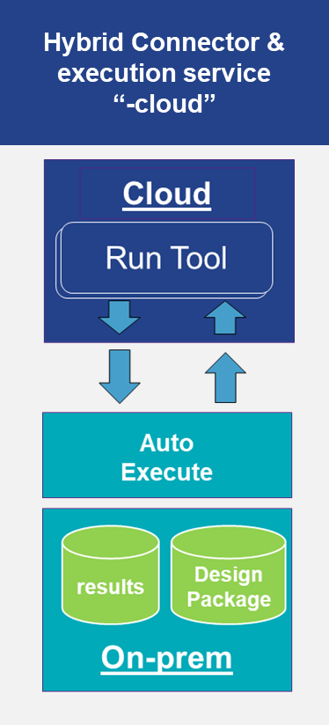
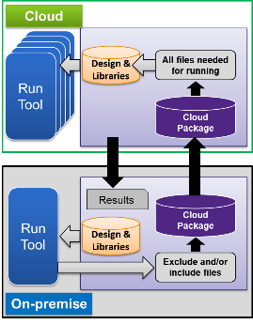

Cloud Building Blocks
Cloud Transfer Packager
Cloud Tool Containers
Distributed-Workload Manager
Elastic Scalability
Hybrid Connector
-$cloud
Analog Fault Simulation
Analog Fault Simulation
Analog Fault Simulation
Implementation
Container
Adds Cores on the fly
Synopsys App
Bins/Libs
Singularity Container Engine
Redhat OS 7.X
Synopsys Confidential Information

Slide 38
SCTP : Synopsys Cloud Transfer Packager
On Premises
Reference TestCase
Product Integration Guide : https://sweportal/sde/sctp/Pages/Product-Integration.aspx
DEFINITION : Create & Xfer packages to & from premises to cloud
/depot/tools/sctp/sctp
Run test case with SCTP
Key features
Standalone / Product independent
Generate/Pack & Unpack full data dependency tree*
Multithreaded execution
Maintains environmental namespace on-prem to cloud
MT & Distributed support
Reduces upload files sizes
Comprehensive exclusion rule set
Full Incremental functionality / overlay
Upload & download
Package creation for Hybrid model execution (-cloud)
Exclude and/or Include files
Convert & Pack
Upload
Unpack
Run Tool
Download output
*requires tool run

Slide 39
CDPL: build complex distributed flows in our tools
Simple, uncoupled operations
Worker 1
A1
H9
A3
T7
B9
C10
X45
Highly parallel operations
Single-lane sequenced fast operations
Operations with dynamic dependencies
Batched/staged operations
Worker N
C4
F2
N9
G2
Q123
P9
Simple, time dimension flows
Worker 1
Time N, Area1
…
Time3, Area1
Time2, Area1
Time-1, Area1
Domain specific tasks
T1
T3
T4
T6
T2
T5
T7
Phases, Checkpoints
T3
T4
T1
T6
T5
T2
Stage3
Stage2
Stage1

Slide 40
Examples of applications (today, and in the works)
Large and Complex DP possibilities
Single-product/Multi-product flow
Single product, very large scale flow (WIP)
ToolA
Worker1
Worker11
L2
Spice Worker
Spice Worker
Worker1 L1
Worker12
L2
Tool A
Worker2
Master1 L2
TA Worker
Tool A
Master
Flow
Master
Level 1
Worker13
Level2
ToolB
Worker3
Worker2 L1
P and R Worker
Master2 L2
Worker21
Level2
ToolB
Worker4
DRC Worker
DRC Worker
DRC Worker
Worker3 L1
Master3 L2
Worker31
Level2
ToolC
Worker5
OPC Worker
OPC Worker
OPC Worker
Worker32
Level2

Slide 41
CDSL – providing a data management backplane
PERSISTENCE
LAYER
IN-MEMORY BACKENDS
Master
Data API
NFS
Key-Value store
PERSIST
Data API
OBJECT STORE
Worker
Data API
Worker
Data API
RDBMS
(planned)
Worker
Data API
Cloud Store
Notes:
Single Interface to multiple storage solutions
Key-Value, Distributed File System, Database
Composite Systems: i.e. Caching, Memory + Key-Value + Disk
Simplify storage selection and configuration
User configurable on a per application basis
Scalable performance and productivity
Provide proven distributed backends
Correctness checks
Performance metrics
Less about the interoperability, more about IT taking on the software/infrastructure challenges associated with individual solutions.

Slide 42
CDSL use model: single instance
Start and use one in-memory Key-Value Store
Single Data Server (CDSL)
Worker
Data API
Memory
Worker
Data API
Worker
Data API
…
Distributed Application
Worker
Data API
cdslPut(…)
cdslGet(…)

Slide 43
Horizontally scaled CDSL Data Servers
Shard data across a pool of in-memory Key-Value Stores
Multiple DataServers
Worker
Memory
Memory
Data API
Worker
Data API
Worker
Memory
Memory
Data API
…
Distributed Application
Worker
Data API
cdslPut(…)
cdslGet(…)

Slide 44
Case Study 1 - VCS
Synopsys Confidential Information - Internal Use Only

Slide 45
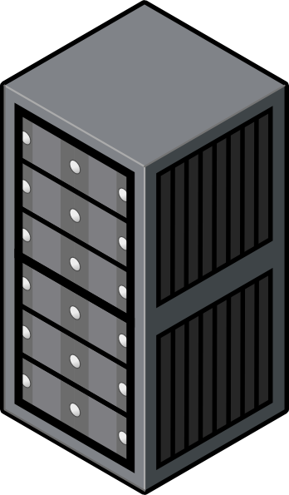

VCS – Data Consistency / Transfer
Future Work
Eliminate NFS bottlenecks on cloud
Read only partitions backed by object store with a Posix interface
Sync of summarized ML data on cloud and on-prem
Distributed constraints caching
Generic VCS Compile Containers
Specialized VCS Runtime Container
Generic VCS Runtime Container
QSC + Tool Layer
User Layer
simv
OS Layer
QSC + Tool Layer
QSC + Tool Layer
Storage Mount
OS Layer
OS Layer
Storage Mount
Storage Mount
Design DB
Compile logs
Data Mirror Layer
Runtime Input & Output
Container Registry
simv
On Premise
Public Cloud

Slide 46
VCS Container Use Model
vcs –container=singularity[:path to base image] –container_include=<file name>
If path to base image is not specified, default image is used from the vcs installation
File name is the path to a file that contains a list of directories/files to the copied into the container image
vcs –container=docker:[from_registry/]image_name[:version] –container_include=<file name> -container_publish=to_registry
from_registry is the details of the registry where the base container image is available
to_registry is the details of the registry when the built image should be published
File name is the path to a file that contains a list of directories/files to the copied into the container image

Slide 47
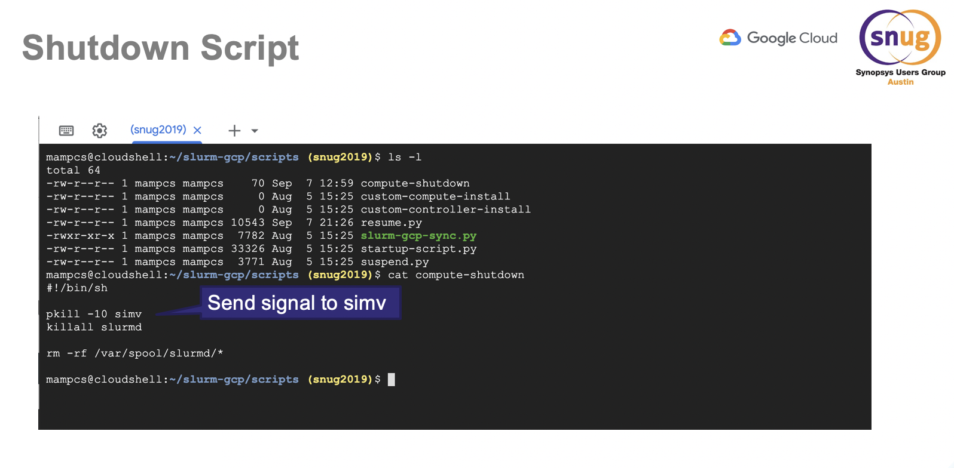
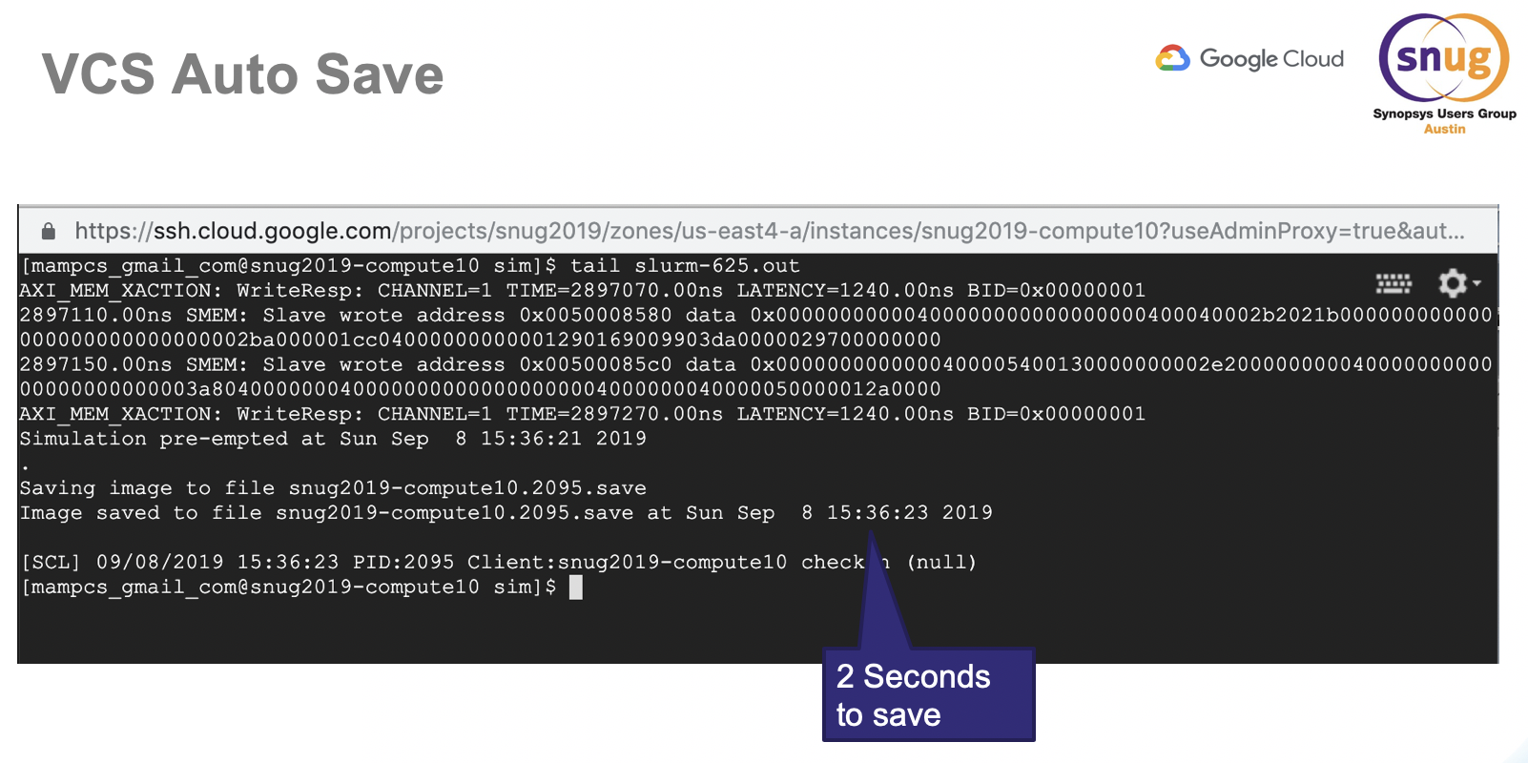
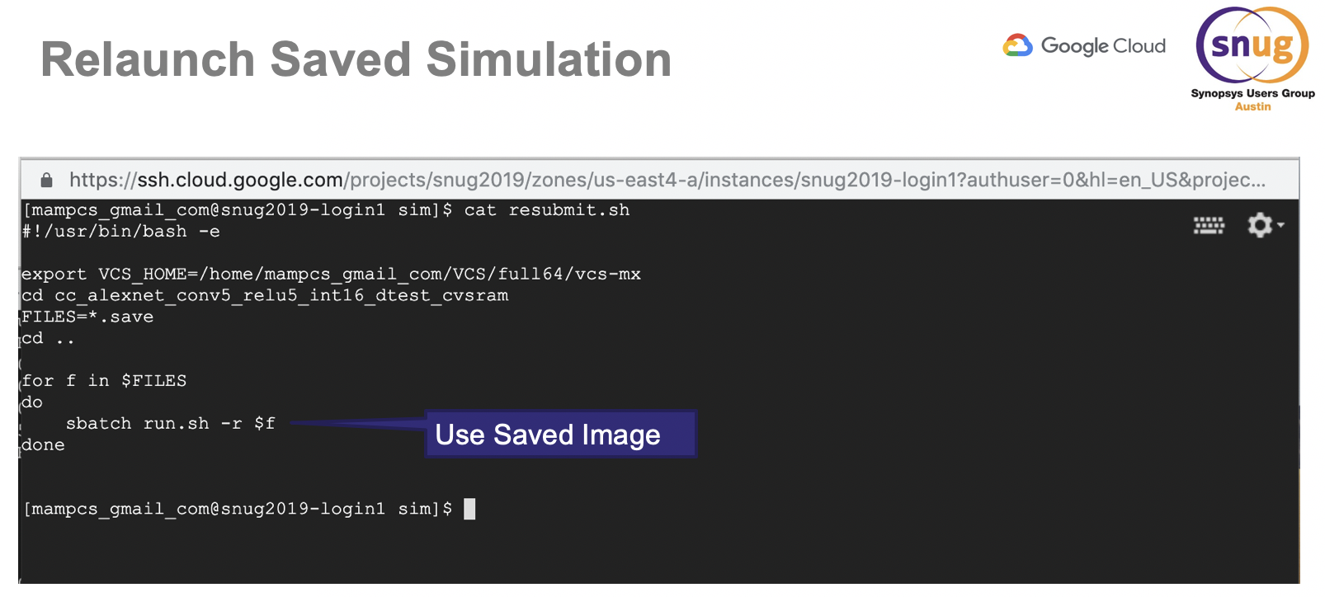
VCS - Spot Instances
Future Work
Support for other cloud providers
Tighter integration with schedulers for restart
LSF
Univa
Periodic saves
Support for heterogeneous instance types
Selection of spot instances based on spot pricing and simulation job requirements

Slide 48
Case Study 2 – ICV
Synopsys Confidential Information - Internal Use Only

Slide 49
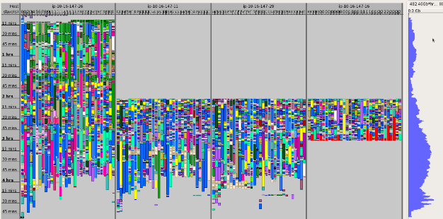
ICV - Elastic Scalability Technology for the Cloud
Add cores on the fly to a running job
Example: IC Validator Elastic Scalability
Expected
completion
Launch ICV on 32 cores
Traditional
Job
Cores
Add 96 cores on the fly
Add cores on the fly
Memory
Elastic Scaling
Job
IC Validator Commands Execution
+
Release 32 Cores
Synopsys Confidential Information

